Slide 1

Tagged Particle Diffusion in Quasi One-Dimensional Gas with Hamiltonian Dynamics
Made by:
Arya Ladhani
2020BB10026
Guided by:
Professor Anjan Roy

Slide 2
Content
What is Diffusion?
Bulk Diffusion
Transport Equations
Single File diffusion
Motivation of this project
Principles used
Event Driven Algorithm
Experimental Set-Up
Observations
Results & Discussions
Future Plan of Action

Slide 3
What is Diffusion?
Diffusion refers to the random motion of gas molecules (or atoms) which is stochastic in nature and is governed mainly by stochastic models.
In this project we attempt to make more deterministic models of diffusion in order to increase the applications of diffusion and understand processes involving diffusion more deeply.

Slide 4
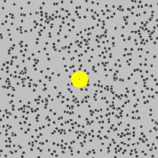
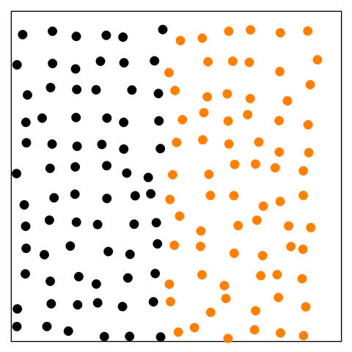
Particle Diffusion
Bulk Diffusion
Random movement of particles of individual particles in a fluid medium
Occurs on a micro-scale
Follows zig-zag or Brownian motion
Net movement of a substance in a bulk material
Occurs on a macro-scale

Slide 5
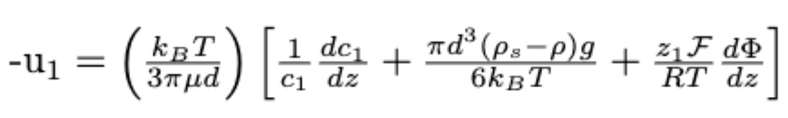
Transport Equations
Diffusive term
Electric Potential Term
Gravitational term

Slide 6
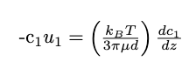
Special Case

Slide 7


Particle Diffusion in 3 D
Single File Diffusion
One Dimensional motion of particles
Three dimensional motion of particles

Slide 8
Motivation of this project
Use Cases of Single-File Diffusion in Biology:
Ion Channels: Ion channels are protein structures that allow the passage of ions (e.g., sodium, potassium, calcium) across cell membranes. In many cases, ions move through these channels in a single-file fashion.
Protein Transport: In many biological processes, proteins and other macromolecules need to be transported through narrow channels or pores within cellular structures.
Transport Across Cell Membranes: Small molecules and ions often need to traverse cellular membranes to enter or exit cells.

Slide 9
While prior research about diffusion in Hamiltonian systems exists, the conclusions drawn are from stochastic models or are deterministic for very ideal, one-dimensional motion.
Amongst other tasks, this project is based upon these two activities:
Verifying results for deterministic one-dimensional systems with stochastic models through simulations
Finding relations for Quasi one-dimensional systems through simulations

Slide 10
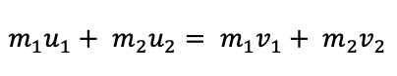
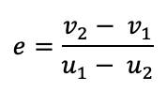
Principles used in the experiment
(Assuming Hard Particle Collisions)
Collision of 2 bodies
When 2 bodies collide elastically (perfectly/imperfectly/ non-elastic), the relation between momentum, velocities and co-efficient of restitution is given by these two equations:
Law of conservation of Momentum**:
Co-efficient of restitution**:
Gaussian Distribution
We have used the Gaussian distribution function to randomly distribute N particles in the container of length ‘L’.
**Where, mi is the mass of the ith component in the system, ui is the velocity of the ith component before the collision and vi is the velocity of the ith component after the collision, e is the co-efficient of restitution and is also a measure of the elasticity of collision

Slide 11
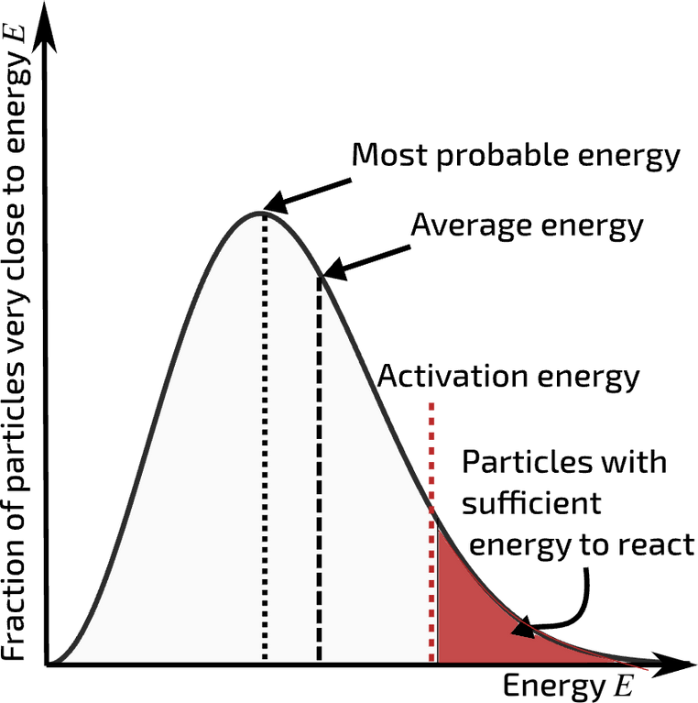
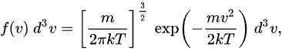
Boltzmann Distribution of Velocity
We acquire meaningful thermodynamic averages and observables by ensuring that our simulations follow the rules of statistical physics, which is made possible by the Boltzmann velocity distribution**.
**The Maxwell–Boltzmann distribution is a bell-shaped curve, with the most probable speed in the middle and the probability of finding a molecule with a higher or lower speed decreasing on either side. The shape of the curve depends on the temperature of the gas. At higher temperatures, the molecules have more energy and can move faster, so the curve is broader and shifted to the right. At lower temperatures, the molecules have less energy and can move slower, so the curve is narrower and shifted to the left.

Slide 12
Event Driven Algorithm
Initialization
Event Detection
Event Selection
Energy and Momentum Conservation
Time Advancement
Event Execution
The algorithm is repeaated for the time of simulation

Slide 13

Experiment 1
We simulated the experiment with following initial conditions**:
1.Length of container: 1 m
3.Temperature: 400 K
4.Number of Particles: 10
For our studies we have tagged the centre particle and we record various of its parameters(velocities and positions at different time stamps) for our future observations and analysis.
** In deterministic systems the randomness arises from inital conditions only. Hence, in ideal cases it is better to conisider real life systems

Slide 14
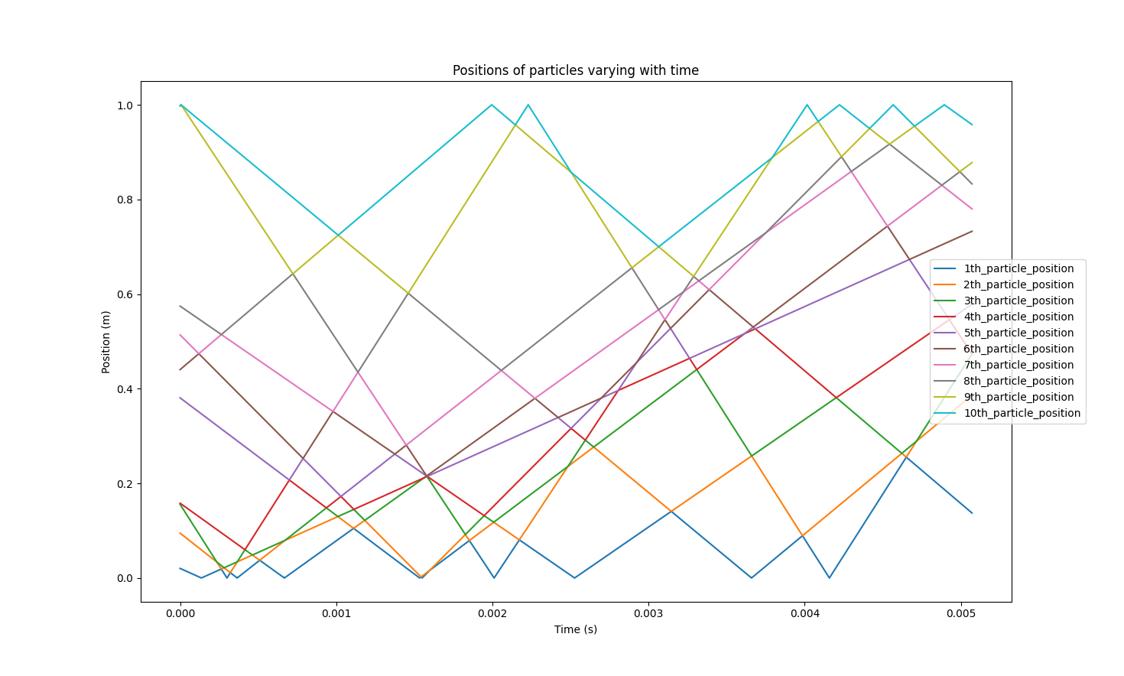
Observations
We run simulations for a 10-particle ensemble in which all particles have equal mass and collisions are elastic.
We then record at all times of the simulation the position of each particles.

Slide 15

Observations
These points of intersection of lines denote collision between 2 bodies.
The reflection of trajectory at boundaries signify collision of particles with the wall of container.
On close observation, one can notice that intersecting lines actually exchange their slopes i.e. after collision equal mass particles exchange velocities for elastic collisions.

Slide 16
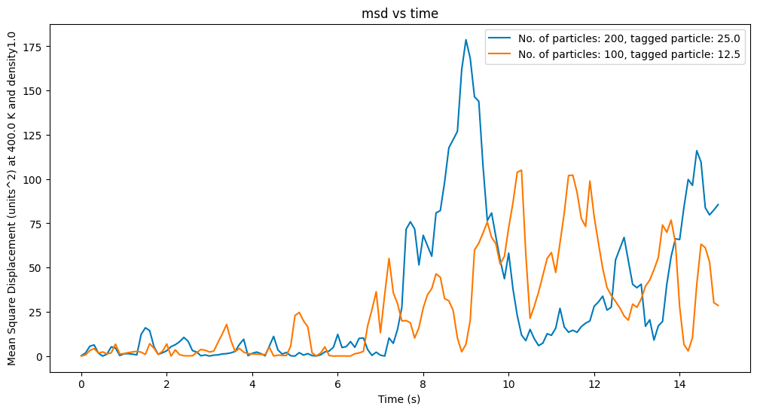
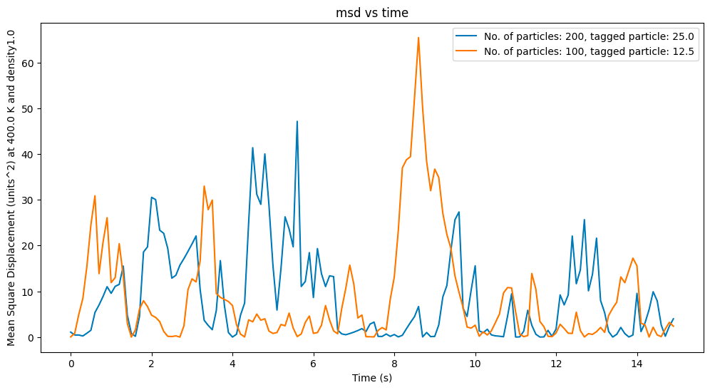
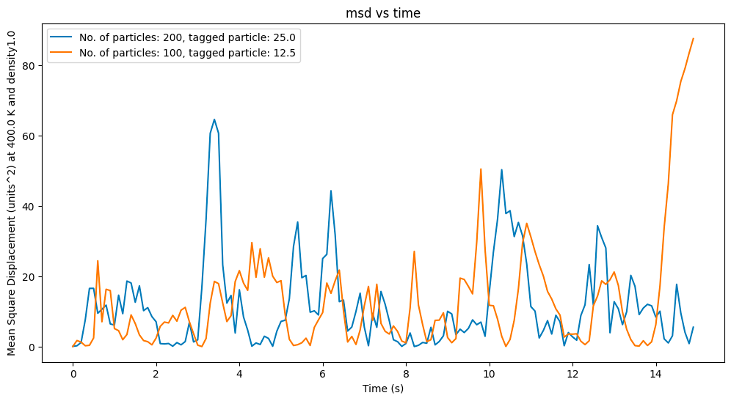
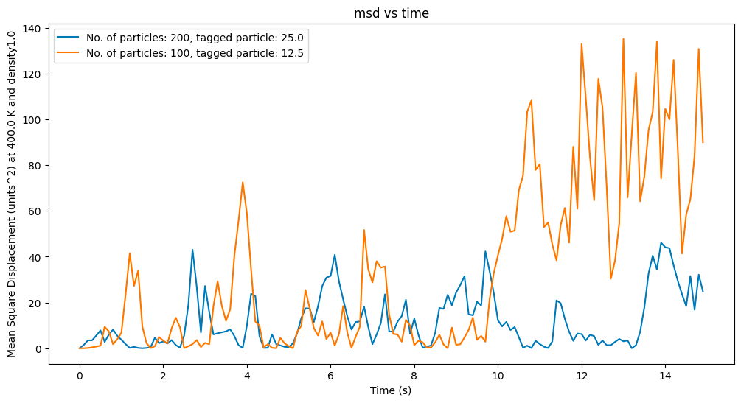
But the results we obtained were rather random....

Slide 17
How did we tackle this issue?
We tackled the issue of random results by averaging out the metrics we are measuring over 100s of realizations
Why was this solution also challenging?
While implementing the event driven algorithm, the time stamps for which mean square displacement is recorded are unique to every realization as every time stamp is basically just the next collision which is not deterministic because of the random initialisations of velocities and positions.

Slide 18
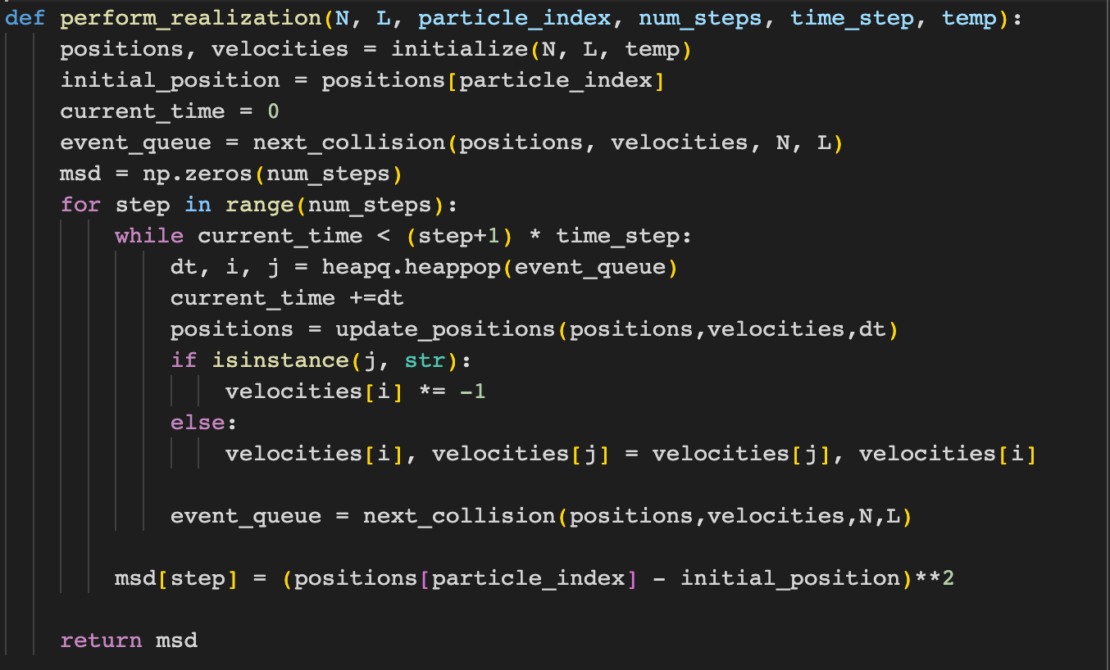
Experiment 2

Slide 19
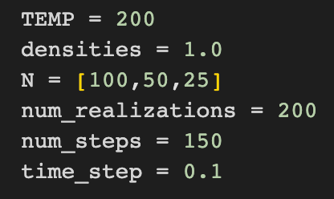
Screening across several realizations

Slide 20
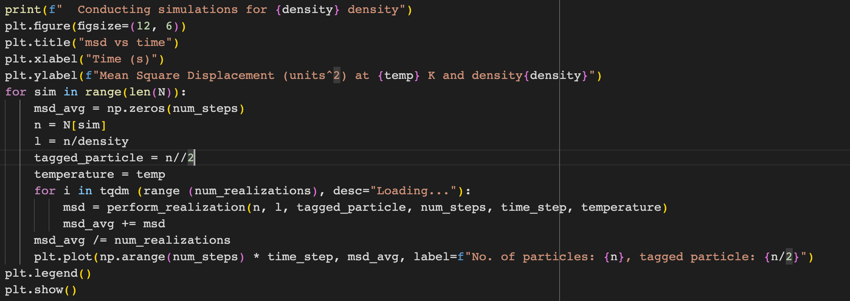
Screening across several realizations

Slide 21
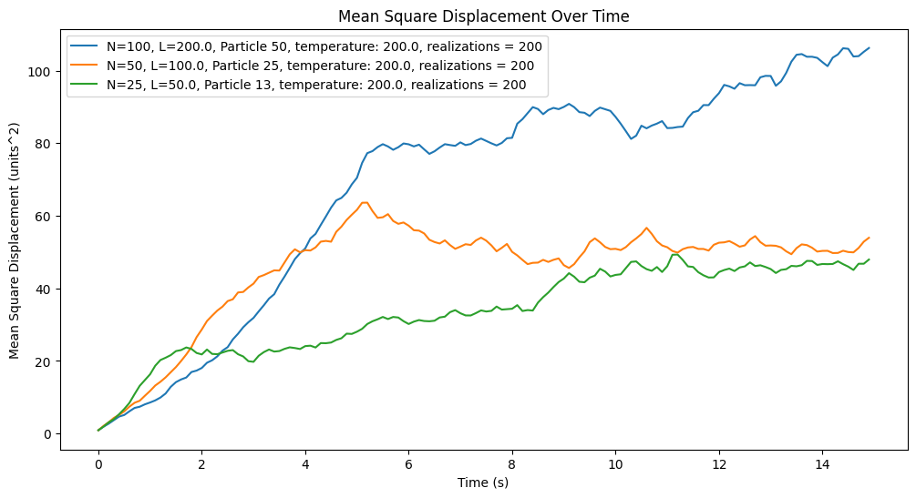
Results (for 200 realizations)

Slide 22
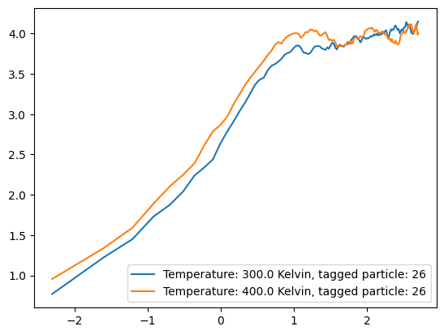
To smoothen the curve we increase realizations
and plot log (msd) vs log (time)
The saturation of the curve is much smoother for 300 realizations

Slide 23
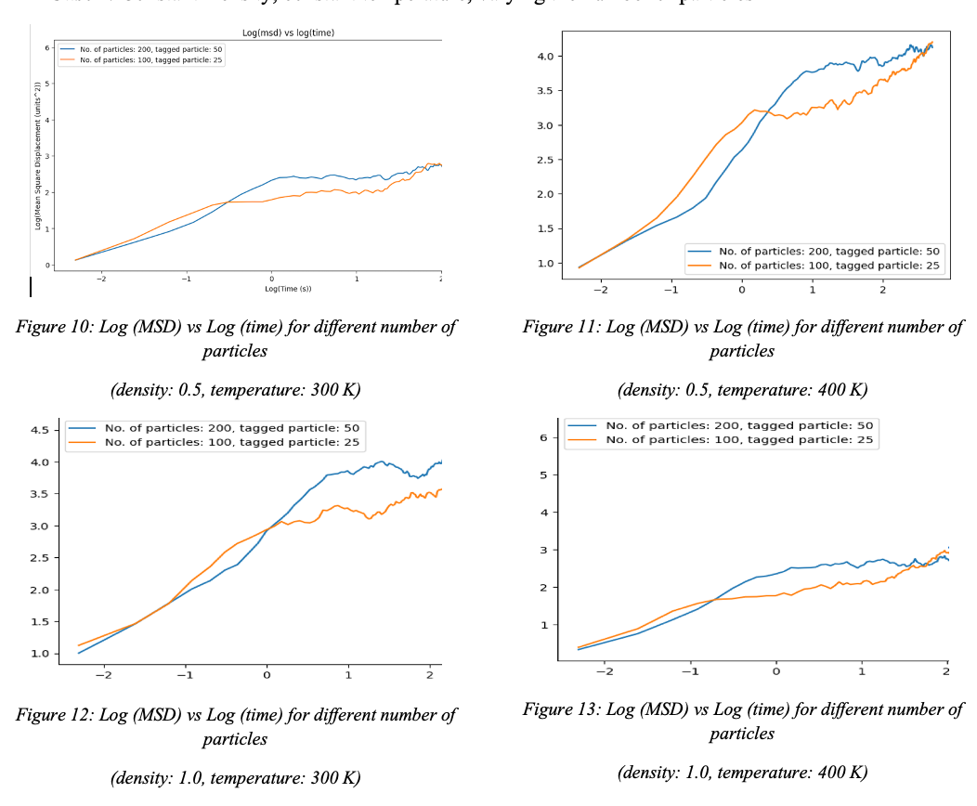
Constant density and size of particles

Slide 24
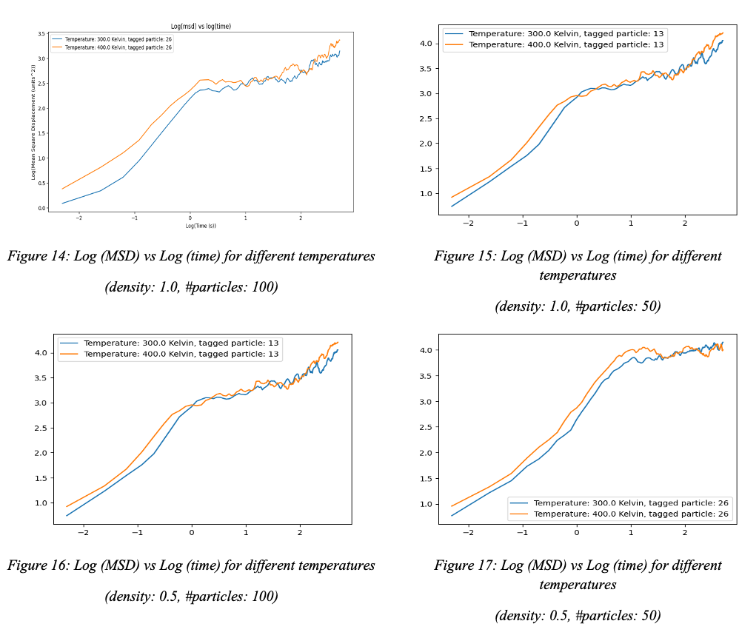
Constant density and size

Slide 25
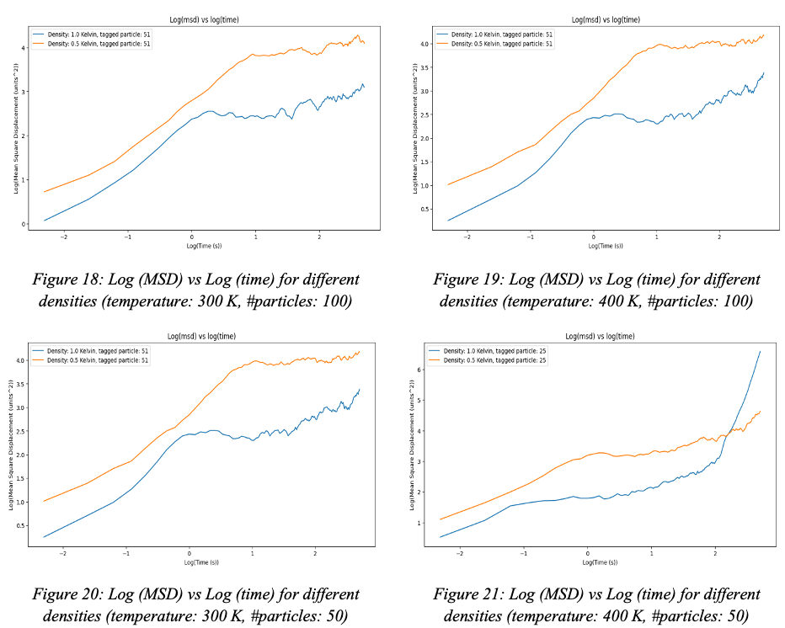
Constant temperature and size of system

Slide 26
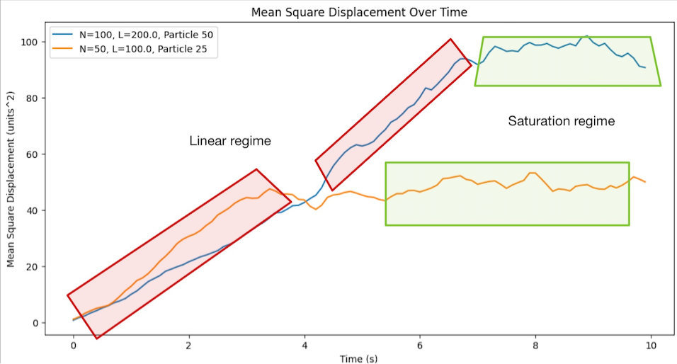
Analyzing Results

Slide 27
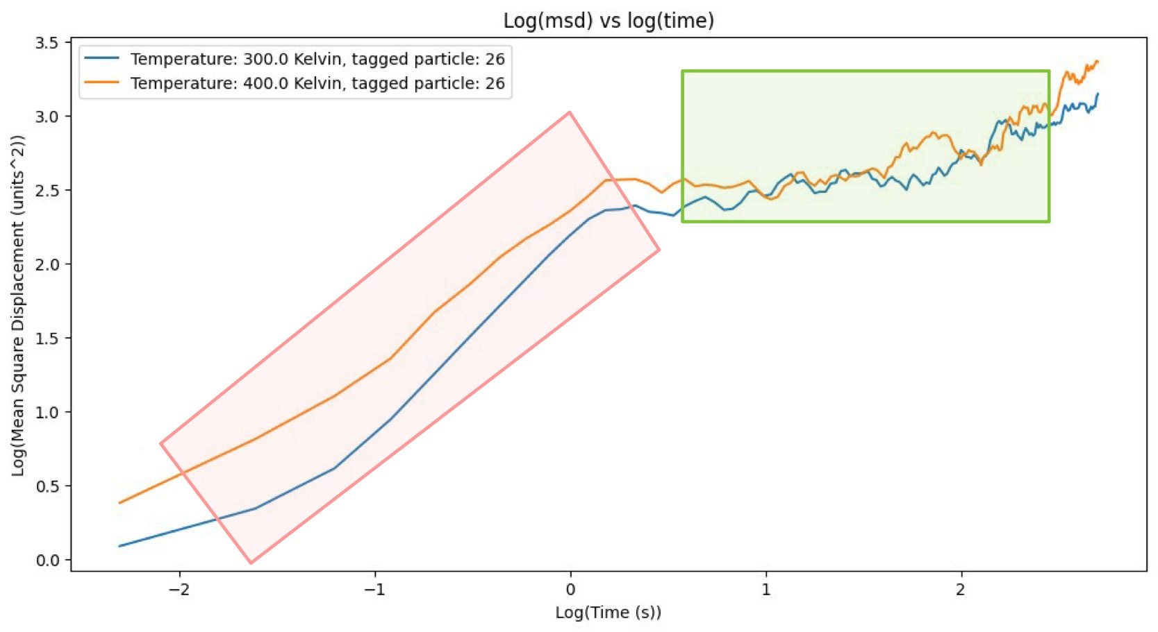
Analyzing Results
Slope = 0 regime (saturation)
Slope = 1 regime (linear relation)

Slide 28
Conclusion
We can conclude the following things :
For a system following Hamiltonian Dynamics, in a single file diffusion, a tagged particle at an average follows has a linear relation between the Mean Square Displacement and time
Log msd vs log t graph also gives coherent results
Till the point of saturation the system is deterministic
Post saturation the system is stochastic in nature

